Slide 1


K.RAMAKRISHNAN COLLEGE OF TECHNOLOGY
(AUTONOMOUS), TRICHY.
DEPARTMENT OF
COMPUTER SCIENCE AND ENGINEERING
20CS5501 DESIGN PROJECT-1
Batch No. : 15
Date : 05.12.2024

Slide 2
STEP INSIDE OUR KRCT BY CAMPUS 360ﹾ
Guided by Team
Dr.A.Delphin Carolina Rani ME,Ph.D., Danu Priya S (811722104025)
Head of the Department, Elakkiya A (811722104037)
Professor, CSE Indhumathi S (811722104056)

Slide 3
OBJECTIVE OF THE PROJECT
Enable prospective students, parents, and other stakeholders to explore the campus from anywhere in the world, breaking geographical and logistical barriers.
Virtual tour is a virtual view of the institution without our physical presence. Here we can explore , roam to many places in that institutions.
It is an 360ﹾ view of the institution. To design this project we use web development methodology.
Using virtual view we can interact with the corresponding environments.

Slide 4
ABSTRACT
The Virtual Campus Tour is a powerful recruitment tool but also a way to introduce future students to the vibrant, dynamic, and diverse community at K.Ramakrishnan college of technology. Whether considering applying, seeking information, or simply exploring, this tour offers an accessible, informative, and convenient way to experience the college virtually, making it easier for individuals to make informed decisions about their academic future.
Using virtual tour we can view the facilities available in the locations.

Slide 5
LITERATURE SURVEY
TITLE OF THE PAPER | AUTHOR (S) | PUBLISHER | PAPER GIST | TECHNOLOGY USED
Creating a 360-degree customer view: A comprehensive guide. | John Smith | Springer, 2020 | integrating customer data from various sources into a unified view. | Data integration, CRM systems, Big Data analytics
Improving Product Development Using 360-Degree Analytics | Laura White | Taylor & Francis, 2021 | the product lifecycle enhances decision-making, accelerates development, and aligns products with customer needs. | Predictive analytics, Feedback systems, AI
The Business Data Lake and the 360-Degree View | Emily Taylor | McGraw-Hill, 2020 | enabling a comprehensive 360-degree view of their business for improved decision-making and customer insights. | Data lakes, Big Data, Predictive and Prescriptive analytics
The Future of Immersive Media: 360-Degree Video Technology | Alex Cooper | ACM Digital Library, 2019 | explores the potential of 360-degree video technology to revolutionize entertainment, education, and marketing. | 60-degree cameras, VR (Virtual Reality), Immersive media
Employee Engagement and the Power of 360-Degree Reviews | Lisa Brown | Palgrave Macmillan, 2020 | discusses how 360-degree feedback, involving input from peers, managers, and subordinates. | Online survey platforms, Cloud-based HR systems

Slide 6





PROPOSED SYSTEM ARCHITECTURE
USER
KRCT WEBSITE
VIDEO TOUR
HOTSPOTS
VIRTUAL CAMPUS

Slide 7
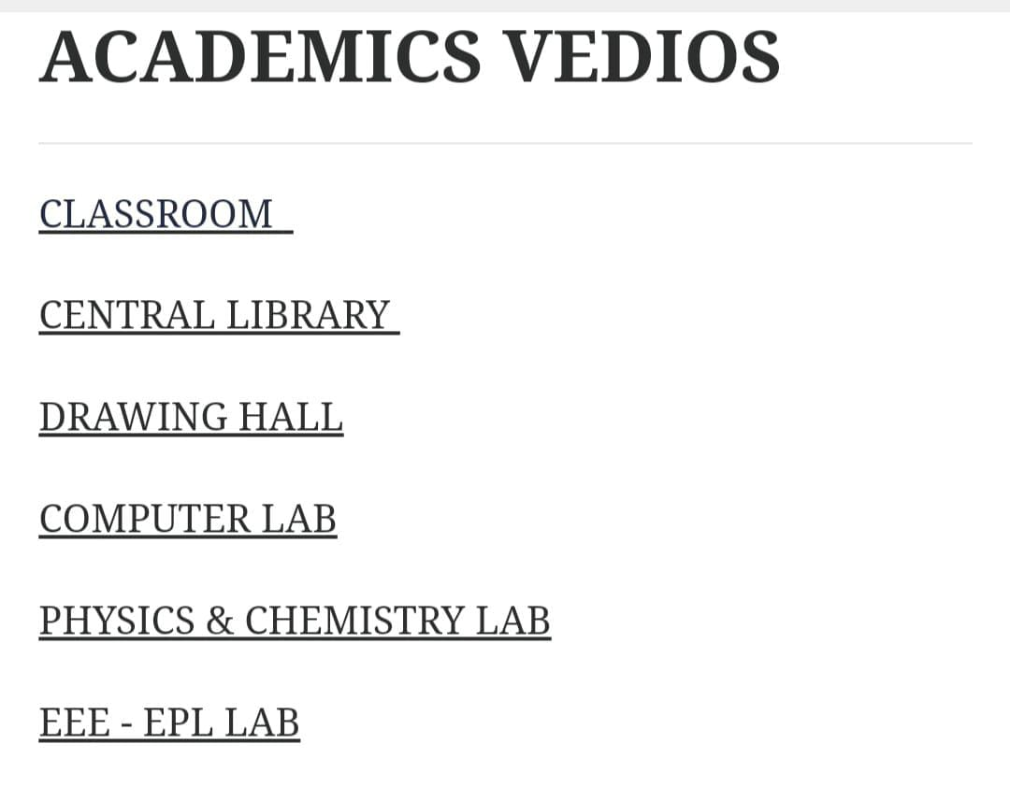
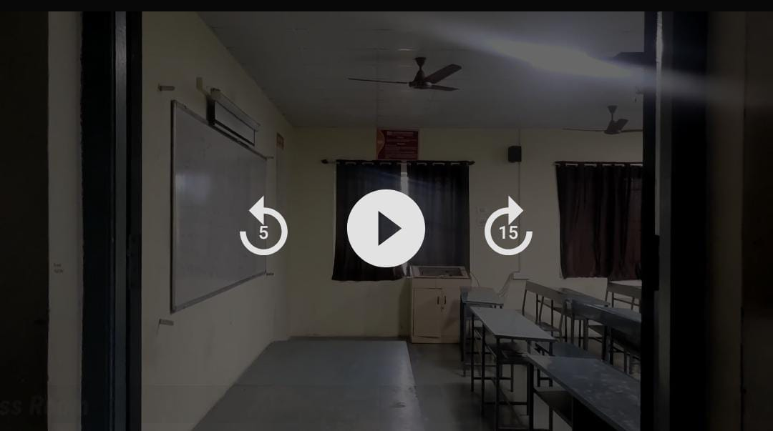
EXISTING SYSTEM ARCHITECTURE
USER
KRCT WEBSITE
VIDEO TOUR
PLAY VIDEO
SELECT
Eg:classroom

Slide 8
SOFTWARE AND HARDWARE REQUIREMENTS
HARDWARE
SOFTWARE
Workstation (PC/Laptop)
Insta 360ﹾ camera
Operating System (OS)
Marzipano
Insta360 Studio
Visual studio

Slide 9
MODULES
Image Capture Module
Convert Image from .insp to .jpg Module
Interactive Hotspots and Navigation Module
Create Website Module
Merge Image navigation video with code Module

Slide 10
SUMMARY OF MODULE-1
1.Image Capture Module
Take photo of the corresponding location in Insta 360ﹾ Camera.
Cover all the locations in individual photos.
Take every photos in the perfect angle so that the image navigation will be proper.
Cover all the pathways of the location to give proper interactive environment.

Slide 11
SUMMARY OF MODULE-2
2.Convert Image from .insp to .jpg Module
Open all the photos one by one in Insta 360 studio.
Then change format of the photo to .jpg with some dimensions change .
Then save those photos with proper location name in one common folder.

Slide 12
SUMMARY OF MODULE-3
3.Interactive Hotspots and Navigation Module
Combine all the photos.
Arrange them in a order like a video.
Then give proper navigation to be assigned for the photos. So that the next location can be open while clicking the navigations arrow. To give proper video tour. Then covert it to code and run and check.

Slide 13
SUMMARY OF MODULE-4
4. Create Website Module
Create a html code for website.
Give proper content to displayed.
Give proper buttons operation. Design with CSS code.
Check whether the code run independently and good.
Languages used:
Html , CSS3.

Slide 14
SUMMARY OF MODULE-5
5. Merge Image navigation video with code Module
Create a button that opens the image navigation video in the Html code designed for website .
Merge code with image navigation video.
Alter with CSS for further designs and colours , sizes etc..
Languages used:
Html , CSS3.5

Slide 15
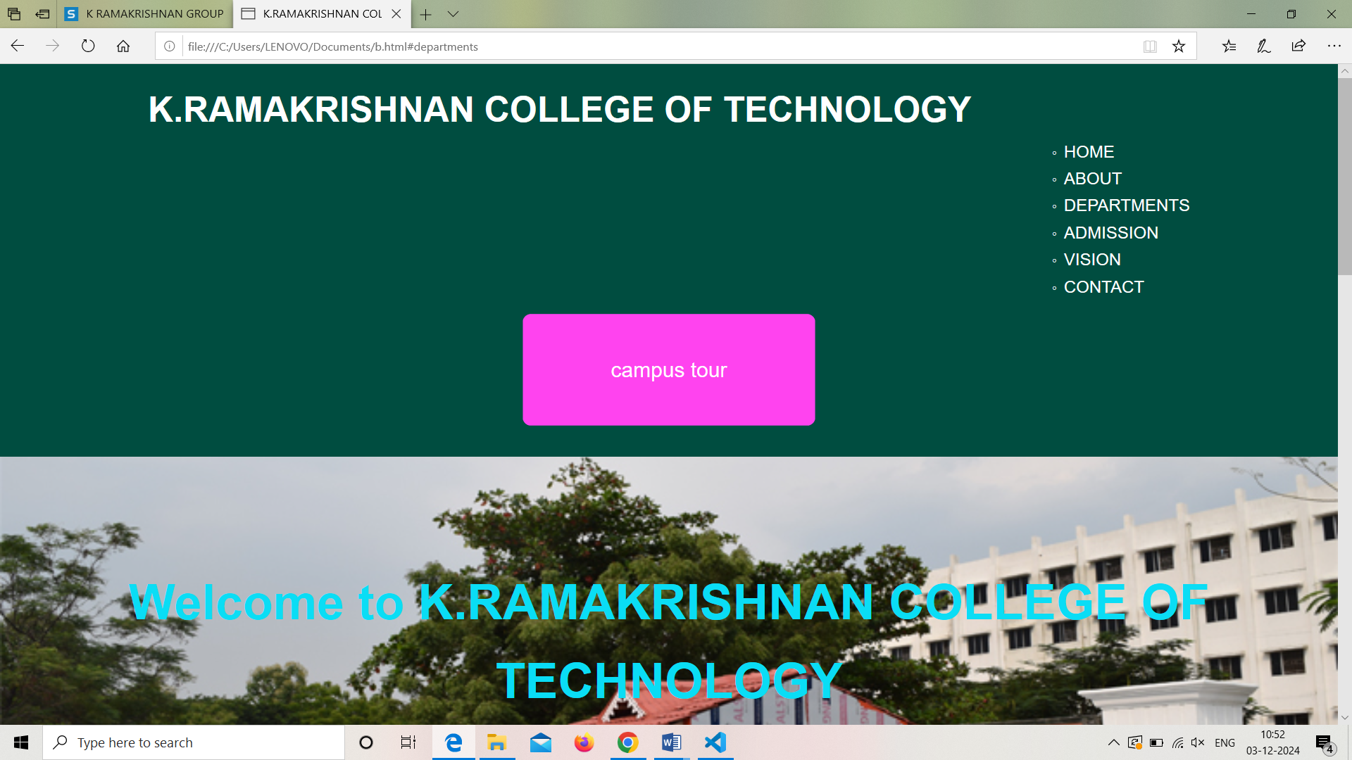
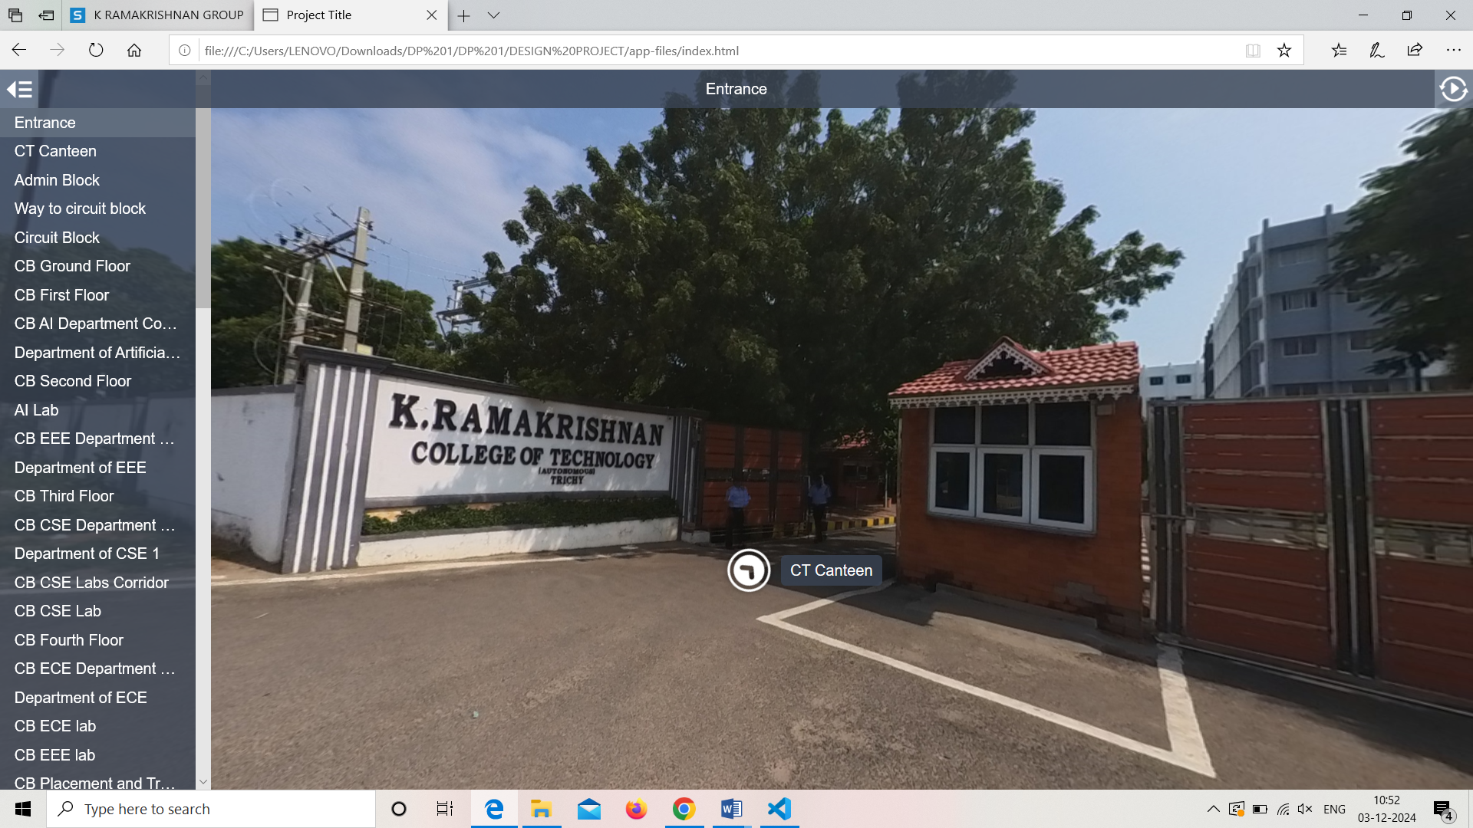
RESULTS AND DISCUSSION

Slide 16
CONCLUSION
Virtual tour is a concept of exploring the corresponding location without our physical presence.
The project we have designed for exploring our college campus with 360 ° view . Exploring all the places without our physical presence .
By using advanced technology and interactive elements, virtual tours make it easier to visualize life on campus and help participants make confident decisions about their future educational journey.

Slide 17
THANK YOU

